Slide 1

PROJECT PROPOSAL
Blockchain-Enabled IoT Traceability &
Cold Chain Monitoring
For Kenya's Horticultural Export Industry
CALEB MURITHI (C026-01-0762/2023)
SUPERVISOR: DR. GABRIEL KAMAU
DEDAN KIMATHI UNIVERSITY OF TECHNOLOGY
2026

Slide 2
01. Introduction
Background, Research Gaps, & Project Rationale

Slide 3


Background of the Study
Economic Importance
The Perishability Threat
Kenya's horticultural industry is a leading foreign exchange earner, exporting flowers, vegetables, and fruits globally.
Export viability depends completely on continuous cold storage to prevent degradation during long-distance transit.

Slide 4
The Problem Statement
Tampering Vulnerabilities
Fragmented Monitoring
Centralized paper or digital databases lack transparency and are susceptible to fraudulent quality modifications.
Current systems rely on manual checks, leading to delayed temperature detection and export rejections.

Slide 5






Research Objectives
1. Edge IoT Node
2. Secure Ledger
3. Trace Portal
Build an active sensor system for localized temperature & humidity tracking.
Develop a smart-contract architecture on Blockchain to lock checkpoint logs.
Implement QR tags to let inspectors instantly trace batch authenticity.

Slide 6
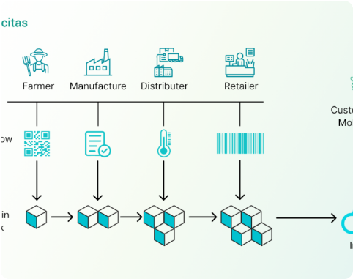

System Architecture
→
Sensing Layer: Live ESP32 nodes sampling conditions.
→
Off-Chain Storage: Scalable Firebase telemetry logs.
→
Blockchain Layer: Smart Contract state checkpoint locks.
→
Traceability Portal: End-user QR scan gateway verification.

Slide 7
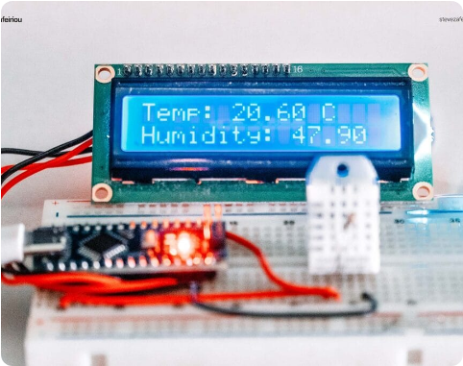
IoT Sensing Infrastructure
→
DHT22 High-Precision Sensors: Capture continuous data.
→
ESP32 Microcontroller: Connects edge to standard networks.
→
Real-Time Data Engine: Firebase updates dashboard fast.
→
Automated Threshold Alarms: Flags environmental breaches.

Slide 8
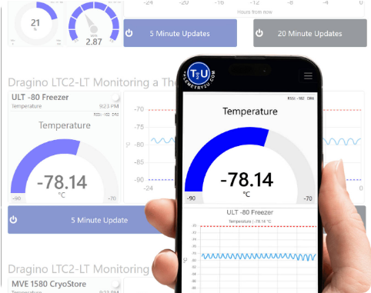
Blockchain Ledger Strategy
→
Polygon Amoy Network: Low transaction gas fees.
→
Hash Anchoring: Checkpoints locked cryptographically.
→
Traceability QR Engine: Auto-generates unique print tags.
→
Immutable Records: Prevent retrospective data edits.

Slide 9





Implementation Technologies
Core Firmware
Smart Contracts
Web Front-End
Arduino C++ programming on the ESP32 chip platform.
Solidity language engineered via the Hardhat frame.
React dashboard displaying visual chart statistics.

Slide 10
Project Schedule
Sep - Oct
Dec
ESP32 hardware assembly & Solidity deployment testing.
Final system validation, reporting, and defense panel.
Jun - Aug
Nov
Literature review and system modeling design phases.
Dashboard interface implementation & integration audits.

Slide 11

Estimated Project Budget
Category Description | Key Items Included | Cost (KES)
IoT Sensor Nodes | ESP32 Chip, DHT22 Sensor, Prototyping Wires | KES 4,000
Testing Network Data | Developer Bandwidth & Cloud DB connections | KES 4,000
Miscellaneous Logistics | Travel & Technical validation reports printing | KES 6,000
Reserve Contingency | Hardware replacements & dynamic components backup | KES 3,000
TOTAL PROJECT BUDGET | Implementation & Prototype Testing Costs | KES 17,000

Slide 12

Questions & Discussion
Thank you for your valuable time and consideration.

Slide 13



Image Sources
https://sp-ao.shortpixel.ai/client/to_auto,q_glossy,ret_img,w_1100,h_564/https://www.primafelicitas.com/wp-content/uploads/2023/09/Understanding-the-Concept-of-Smart-Agriculture-and-Blockchain-Technology-1100x564.png
Source: www.primafelicitas.com
https://stevezafeiriou.com/wp-content/uploads/2024/11/arduino-nano-lcd-dht22-1024x683.jpg
Source: stevezafeiriou.com
https://telemetry2u.com/images/applications/dashboards/temperature-dashboard.jpg
Source: telemetry2u.com

